Slide 1
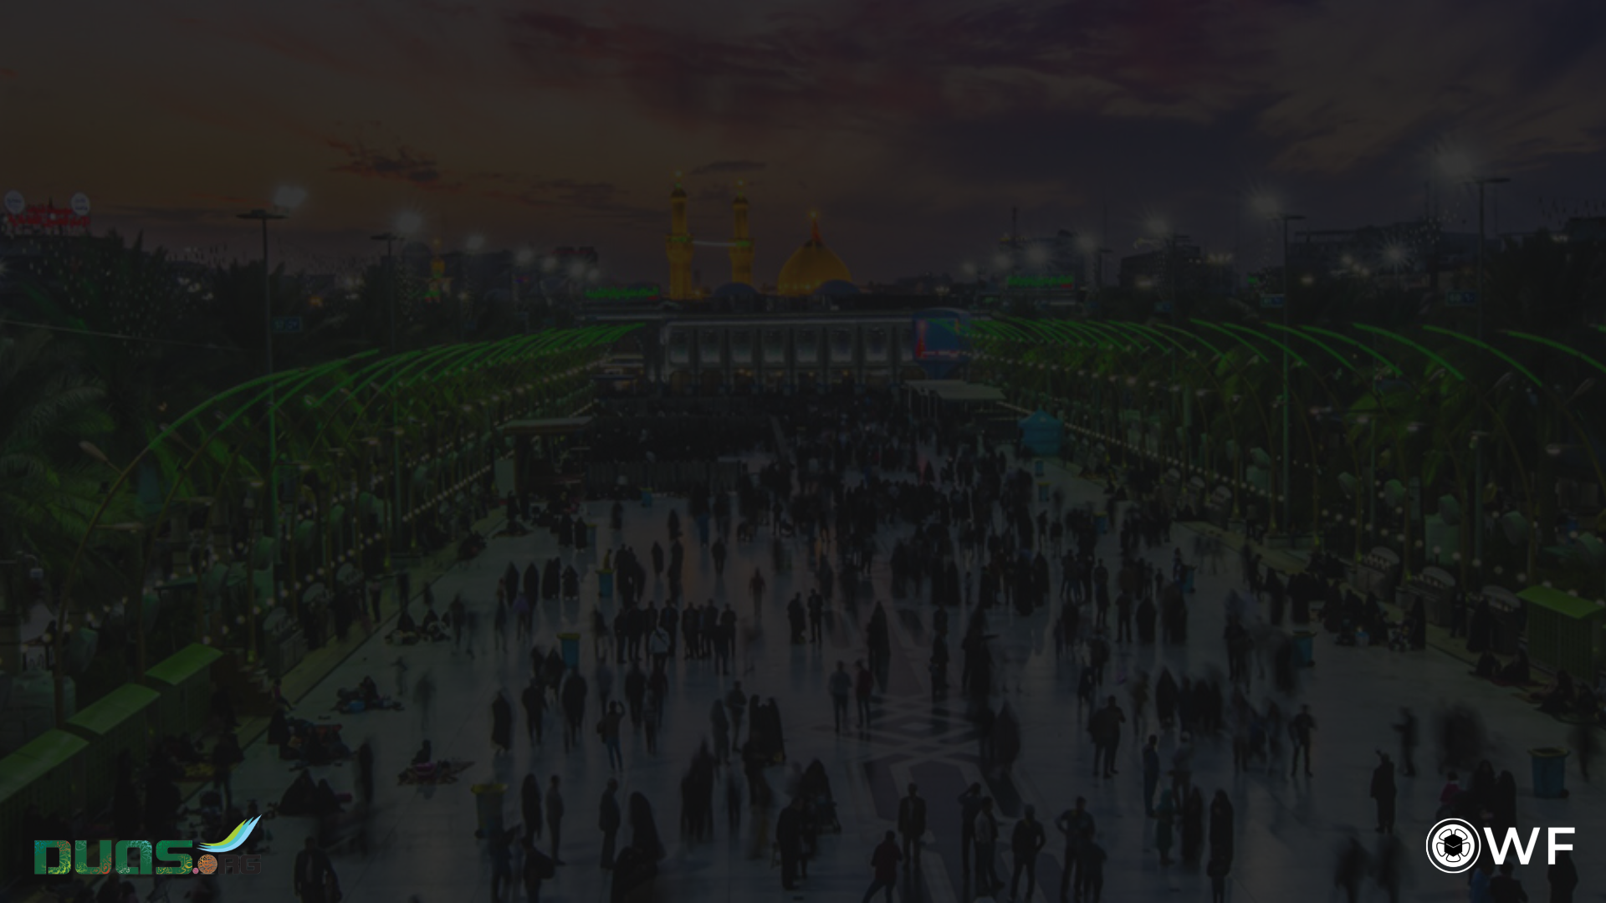
زِيَارَةُ الْأَرْبَعِينِ
Ziyārat al-Arbaʿīn

Slide 2
اَلسَّلَامُ عَلَى وَلِيِّ اللهِ وَحَبِيبِهِ
As-salāmu ʿalā waliyy illāhi wa ḥabībih
Peace be upon the intimate servant of Allah and His beloved,

Slide 3
اَلسَّلَامُ عَلَى خَلِيلِ اللهِ وَنَجِيبِهِ
As-salāmu ʿalā khalīl illāhi wa najībih
Peace be upon Allah’s cherished friend and His noble one,

Slide 4
اَلسَّلَامُ عَلَى صَفِيِّ اللهِ وَابْنِ صَفِيِّهِ
As-salāmu ʿalā ṣafiyy illāhi wabna ṣafiyyih
Peace be upon Allah’s elect and the son of His elect,

Slide 5
اَلسَّلَامُ عَلَى الْحُسَيْنِ الْمَظْلُومِ الشَّهِيدِ
As-salāmu ʿala-l-Ḥusayn il-maẓlūm ish-shahīd
Peace be upon al-Husayn, the martyred and oppressed,

Slide 6
اَلسَّلَامُ عَلَى أَسِيرِ الْكُرُبَاتِ وَقَتِيلِ الْعَبَرَاتِ
As-salāmu ʿalā asīr il-kurubāti wa qatīl il-ʿabarāt
Peace be upon the slain one taken captive by hardships, and remembered through tears

Slide 7
اَللّٰهُمَّ إِنِّي أَشْهَدُ أَنَّهُ وَلِيُّكَ وَابْنُ وَلِيِّكَ
Allāhumma innī ash-hadu annahū waliyyika wabnu waliyyik
O Allah, I testify that he is your intimate servant and the son of your intimate servant,

Slide 8
وَصَفِيُّكَ وَابْنُ صَفِيِّكَ الْفَائِزُ بِكَرَامَتِكَ
Wa ṣafiyyuka wabnu ṣafiyyik al-fāʾizu bi-karāmatik
Your elect, the son of your elect, who has won Your esteem,

Slide 9
أَكْرَمْتَهُ بِالشَّهَادَةِ وَحَبَوْتَهُ بِالسَّعَادَةِ
Akramtahū bi-sh-shahādati wa ḥabawtahū bi-s-saʿāda
You honoured him with martyrdom and awarded him everlasting bliss,

Slide 10
وَٱجْتَبَيْتَهُ بِطِيبِ الْوِلَادَةِ
Wa-jtabaytahū bi-ṭīb il-wilāda
privileged him with a noble birth,

Slide 11
وَجَعَلْتَهُ سَيِّدًا مِنَ السَّادَةِ
Wa jaʿaltahū saiyyidan min as-sāda
and made him a master from among masters,

Slide 12
وَقَائِدًا مِنَ الْقَادَةِ
Wa qāʾidan min al-qāda
a leader from among leaders,

Slide 13
وَذَائِدًا مِنَ الذَّادَةِ
Wa dhāʾidan min adh-dhāda
and a protector,

Slide 14
وَأَعْطَيْتَهُ مَوَارِيثَ الْأَنْبِيَاءِ
Wa aʿṭaytahū mawārīth al-anbyāʾ
You conferred on him the inheritances of the Prophets,

Slide 15
وَجَعَلْتَهُ حُجَّةً عَلَى خَلْقِكَ مِنَ الْأَوْصِيَاءِ
Wa jaʿaltahū ḥujjatan ʿalā khalqika min al-awṣiyāʾ
And, as their successor, granted him authority over your creatures,

Slide 16
فَأَعْذَرَ فِي الدُّعَاءِ وَمَنَحَ النُّصْحَ
Fa-aʿdhara fi-d-duʿāʾI wa manaḥ an-nuṣḥ
So, he called them to You and exhorted unceasingly,

Slide 17
وَبَذَلَ مُهْجَتَهُ فِيكَ
Wa badhala muhjatahū fīka
He gave his all for You,

Slide 18
لِيَسْتَنْقِذَ عِبَادَكَ مِنَ الْجَهَالَةِ وَحَيْرَةِ الضَّلَالَةِ
Li-yastanqidha ʿibādaka min al-jahālati wa ḥayrat iḍ-ḍalāla
To save Your servants from ignorance and errant perplexity,

Slide 19
وَقَدْ تَوَازَرَ عَلَيْهِ مَنْ غَرَّتْهُ الدُّنْيَا
Wa qad tawāzara ʿalayhi man gharrat-hud-dunyā
But against him were arrayed those whom the world had deceived,

Slide 20
وَبَاعَ حَظَّهُ بِالْأَرْذَلِ الْأَدْنَى
Wa bāʿa ḥaẓẓahū bi-l-ardhal il-adnā
Who had traded their share of the next life for the lowest and meanest of this one,

Slide 21
وَشَرَى آخِرَتَهُ بِالثَّمَنِ الْأَوْكَسِ
Wa sharā ākhiratahū bi-th-thaman il-awkas
And sold their hereafter at a loss,

Slide 22
وَتَغَطْرَسَ وَتَرَدَّى فِي هَوَاهُ
Wa taghaṭrasa wa taraddā fī hawāh
Full of vainglory and consumed by selfishness,

Slide 23
وَأَسْخَطَكَ وَأَسْخَطَ نَبِيَّكَ
Wa askhaṭaka wa askhaṭa nabiyyik
They earned Your wrath and that of Your Prophet,

Slide 24
وَأَطَاعَ مِنْ عِبَادِكَ أَهْلَ الشِّقَاقِ وَالنِّفَاقِ
Wa aṭāʿa min ʿibādika ahl ash-shiqāqi wa-n-nifāqi
And obeyed the people of division and hypocrisy amongst Your servants,

Slide 25
وَحَمَلَةَ الْأَوْزَارِ الْمُسْتَوْجِبِينَ النَّارَ
Wa ḥamalat al-awzār il-mustawjibīn an-nār
And those laden with burdens worthy of hellfire.

Slide 26
فَجَاهَدَهُمْ فِيكَ صَابِرًا مُحْتَسِبًا
Fa-jāhadahum fīka ṣābiran muḥtasiban
But he contended with them for You steadfastly and selflessly,

Slide 27
حَتَّى سُفِكَ فِي طَاعَتِكَ دَمُهُ
ḥattā sufika fī ṭāʿatika damuhū
Until his blood was spilled in Your obedience,

Slide 28
وَٱسْتُبِيحَ حَرِيمُهُ
Wa-stubīḥa ḥarīmuh
And his family were mistreated and abused,

Slide 29
اَللّٰهُمَّ فَٱلْعَنْهُمْ لَعْنًا وَبِيلًا
Allāhumma fa-l-ʿanhum laʿnan wabīlā
O Allah, so send a torrent of curses upon them!

Slide 30
وَعَذِّبْهُمْ عَذَابًا أَلِيمًا
Wa ʿadhdhibhum ʿadhāban alīmā
And chastise them with an agonising torment!

Slide 31
اَلسَّلَامُ عَلَيْكَ يَا ابْنَ رَسُولِ اللهِ
As-salāmu ʿalayka yabna rasūl illāh
Peace be upon you, O scion of Allah’s Messenger,

Slide 32
اَلسَّلَامُ عَلَيْكَ يَا ابْنَ سَيِّدِ الْأَوْصِيَاءِ
As-salāmu ʿalayka yabna saiyyid il-awṣiyāʾ
Peace be upon you, O son of the Master of Successors,

Slide 33
أَشْهَدُ أَنَّكَ أَمِينُ اللهِ وَابْنُ أَمِينِهِ
Ash-hadu annaka amīn ullāhi wabnu amīnih
I testify that you were Allah’s trustee and the son of his trustee,

Slide 34
عِشْتَ سَعِيدًا
ʿishta saʿīdā
You lived auspiciously,

Slide 35
وَمَضَيْتَ حَمِيدًا
Wa maḍayta ḥamīda
Left this world admirably,

Slide 36
وَمُتَّ فَقِيدًا مَظْلُومًا شَهِيدًا
Wa mutta faqīdan maẓlūman shahīdā
And died deprived, wronged, and martyred.

Slide 37
وَأَشْهَدُ أَنَّ اللهَ مُنْجِزٌ مَا وَعَدَكَ
Wa ash-hadu ann Allāha munjizun mā waʿadak
I testify that Allah will deliver what He promised you,

Slide 38
وَمُهْلِكٌ مَنْ خَذَلَكَ
Wa muhlikun man khadhalak
Ruin those who betrayed you,

Slide 39
وَمُعَذِّبٌ مَنْ قَتَلَكَ
Wa muʿadhdhibun man qatalak
And chastise those who killed you,

Slide 40
وأَشْهَدُ أَنَّكَ وَفَيْتَ بِعَهْدِ اللهِ
Wa ash-hadu annaka wafayta bi-ʿahd illāh
I testify that you fulfilled your covenant with Allah,

Slide 41
وَجَاهَدْتَ فِي سَبِيلِهِ حَتَّى أَتَاكَ الْيَقِينُ
Wa jāhadta fī sabīlihī ḥattā atāk al-yaqīn
And strived in His way until the certainty of death overtook you,

Slide 42
فَلَعَنَ اللهُ مَنْ قَتَلَكَ
Fa laʿan Allāhu man qatalak
So may Allah curse those who killed you,

Slide 43
وَلَعَنَ اللهُ مَنْ ظَلَمَكَ
Wa laʿan Allahu man ẓalamak
And may Allah curse those who oppressed you,

Slide 44
وَلَعَنَ اللهُ أُمَّةً سَمِعَتْ بِذَلِكَ فَرَضِيَتْ بِهِ
Wa laʿan Allāhu ummatan samiʿat bi-dhālika fa-raḍiyat bih
And may Allah curse the nation that heard about this and accepted it.

Slide 45
اَللّٰهُمَّ إِنِّي أُشْهِدُكَ أَنِّي وَلِيٌّ لِمَنْ وَالَاهُ
Allāhumma innī ush-hiduka annī waliyyun li-man wālah
O Allah, I call on You to bear witness that I am an ally to his ally,

Slide 46
وَعَدُوٌّ لِمَنْ عَادَاهُ
Wa ʿaduwwun li-man ʿādāhu
And an enemy of his enemy,

Slide 47
بِأَبِي أَنْتَ وَأُمِّي يَا ابْنَ رَسُولِ اللهِ
Bi-abī anta wa ummī yabna rasūl illāh
May my father and mother be your sacrifice, O scion of Allah’s Messenger!

Slide 48
أَشْهَدُ أَنَّكَ كُنْتَ نُورًا فِي الْأَصْلَابِ الشَّامِخَة
Ash-hadu annaka kunta nūran fi-l-aṣlāb ish-shāmikha
I testify that you were a light that passed through noble loins,

Slide 49
وَالْأَرْحَامِ الْمُطَهَّرَةِ
wa-l-arḥām il-muṭahhara
and chaste wombs,

Slide 50
لَمْ تُنَجِّسْكَ الْجَاهِلِيَّةُ بِأَنْجَاسِهَا
Lam tunajjisk al-jāhiliyyatu bi-anjāsihā
uncontaminated by the pollutions of pre-Islamic Ignorance,

Slide 51
وَلَمْ تُلْبِسْكَ مِنْ مُدْلَهِمَّاتِ ثِيَابِهَا
Wa lam tulbiska min mudlahimmāti thiyābiha
and never swaddled in its dark clothes,

Slide 52
وَأَشْهَدُ أَنَّكَ مِنْ دَعَائِمِ الدِّينِ
Wa ash-hadu annaka min daʿāʾim id-dīn
I testify that you are one of the pillars of the religion,

Slide 53
وَأَرْكَانِ الْمُسْلِمِينَ
Wa arkān il-muslimīn
one of the supports of the Muslims,

Slide 54
وَمَعْقِلِ الْمُؤْمِنِينَ
Wa maʿqil il-muʾminīn
and the refuge of the faithful.

Slide 55
وَأَشْهَدُ أَنَّكَ الْإِمَامُ الْبَرُّ التَّقِيُّ
Wa ash-hadu annak al-imām ul-barr ul-taqiyy
I testify that you are the good, righteous,

Slide 56
الرَّضِيُّ الزَّكِيُّ الْهَادِي الْمَهْدِيُّ
ar-raḍiyy uz-zakiyy ul-hādiyy ul-mahdī
the pure, the rightly guided Imam who guides others and is pleased with Allah’s will,

Slide 57
وَأَشْهَدُ أَنَّ الْأَئِمَّةَ مِنْ وُلْدِكَ كَلِمَةُ التَّقْوَى
Wa ash-hadu ann al-aʾimmata min wuldika kalimat ut-taqwā
I testify that the Imams descended from you are the word of righteousness,

Slide 58
وَأَعْلَامُ الْهُدَى
Wa aʿlām ul-hudā
the banners of guidance,

Slide 59
وَالْعُرْوَةُ الْوُثْقَى
Wa-l-ʿurwat ul-wuthqā
the firmest handhold,

Slide 60
وَالْحُجَّةُ عَلَى أَهْلِ الدُّنْيَا
Wa-l-ḥujjatu ʿalā ahl id-dunyā
and Allah’s authority over the people of this world,

Slide 61
وَأَشْهَدُ أَنِّي بِكُمْ مُؤْمِنٌ وَبِإِيَابِكُمْ
Wa ash-hadu annī bi-kum muʾminun wa bi-iyābikum
I testify that I believe in you and in your return,

Slide 62
مُوْقِنٌ بِشَرَائِعِ دِينِي وَخَوَاتِيمِ عَمَلِي
Mūqinun bi-sharāyiʿi dīnī wa khawātīmi ʿamalī
and am certain of the ordinances of my faith and the outcomes of my deeds,

Slide 63
وَقَلْبِي لِقَلْبِكُمْ سِلْمٌ
Wa qalbī li-qalbikum silm
My heart is at peace with yours,

Slide 64
وَأَمْرِي لِأَمْرِكُمْ مُتَّبِعٌ
Wa amrī li-amrikum muttabiʿ
My affair follows yours,

Slide 65
وَنُصْرَتِي لَكُمْ مُعَدَّةٌ حَتَّى يَأْذَنَ اللهُ لَكُمْ
Wa nuṣratī lakum muʿaddatun ḥattā yaʾdhan Allāhu lakum
And I am ready to hasten to your aid whenever Allah permits,

Slide 66
فَمَعَكُمْ مَعَكُمْ لَا مَعَ عَدُوِّكُمْ
Fa-maʿakum maʿakum lā maʿa ʿaduwwikum
So I am with you! I am with you! And never with your enemies!

Slide 67
صَلَوَاتُ اللهِ عَلَيْكُمْ
Ṣalawāt ullāhi ʿalaykum
May Allah’s blessings be upon you,

Slide 68
وَعَلَى أَرْوَاحِكُمْ وأَجْسَادِكُمْ
Wa ʿalā arwāḥikum wa ajsādikum
And upon your spirits and your bodies,

Slide 69
وَشَاهِدِكُمْ وَغَائِبِكُمْ
Wa shāhidikum wa ghāʾibikum
upon those of you who are present and those who are absent,

Slide 70
وَظَاهِرِكُمْ وَبَاطِنِكُمْ
Wa ẓāhirikum wa bāṭinikum
and upon your outward aspects and your inner ones!

Slide 71
آمِينَ رَبَّ الْعَالَمِينَ
Āmīna rabb al-ʿālamīn.
Amen, Lord of the Worlds!

