Slide 1
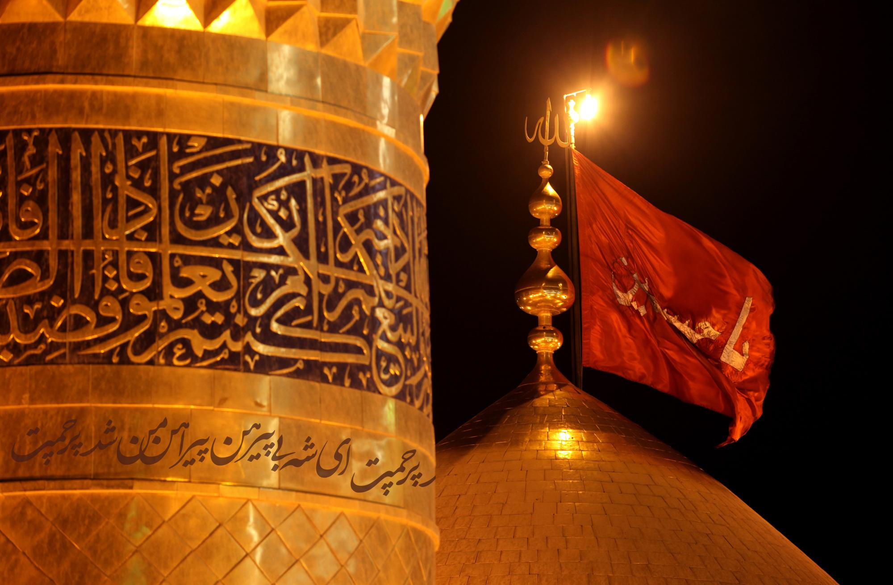
زيارة وارث
Ziyarat Warith

Slide 2
اَلسَّلاَمُ عَلَيْكَ يَا وَارِثَ آدَمَ صَفْوَةِ ٱللَّه
Peace be upon you, O inheritor of Adam the choice of Allah

Slide 3
اَلسَّلاَمُ عَلَيْكَ يَا وَارِثَ نُوحٍ نَبِيِّ ٱللَّهِ
Peace be upon you, O inheritor of Noah the Prophet of Allah

Slide 4
اَلسَّلاَمُ عَلَيْكَ يَا وَارِثَ إِبْرَاهِيمَ خَلِيلِ ٱللَّهِ
Peace be upon you, O inheritor of Abraham the friend of Allah

Slide 5
اَلسَّلاَمُ عَلَيْكَ يَا وَارِثَ مُوسَىٰ كَلِيمِ ٱللَّهِ
Peace be upon you, O inheritor of Moses the spoken by Allah

Slide 6
اَلسَّلاَمُ عَلَيْكَ يَا وَارِثَ عِيسَىٰ رُوحِ ٱللَّهِ
Peace be upon you, O inheritor of Jesus the spirit of Allah

Slide 7
اَلسَّلاَمُ عَلَيْكَ يَا وَارِثَ مُحَمَّدٍ حَبِيبِ ٱللَّهِ
Peace be upon you, O inheritor of Muhammad the most beloved by Allah

Slide 8
اَلسَّلاَمُ عَلَيْكَ يَا وَارِثَ امِيرِ ٱلْمُؤْمِنِينَ عَلَيْهِ ٱلسَّلاَمُ
Peace be upon you, O inheritor of the Commander of the Faithful, peace be upon him

Slide 9
اَلسَّلاَمُ عَلَيْكَ يَا بْنَ مُحَمَّدٍ ٱلْمُصْطَفَىٰ
Peace be upon you, O son of Muhammad the well-chosen Prophet

Slide 10
اَلسَّلاَمُ عَلَيْكَ يَا بْنَ عَلِيٍّ ٱلْمُرْتَضَىٰ
Peace be upon you, O son of `Ali the well-pleased

Slide 11
اَلسَّلاَمُ عَلَيْكَ يَا بْنَ فَاطِمَةَ ٱلزَّهْرَاءِ
Peace be upon you, O son of Fatimah Al-Zahraa

Slide 12
اَلسَّلاَمُ عَلَيْكَ يَا بْنَ خَدِيـجَةَ ٱلْكُبْرَىٰ
Peace be upon you, O son of Khadijah Al-Kubra

Slide 13
اَلسَّلاَمُ عَلَيْكَ يَا ثَارَ ٱللَّهِ وَٱبْنَ ثَارِهِ
Peace be upon you, O vengeance of Allah, son of His vengeance

Slide 14
وَٱلْوِتْرَ ٱلْمَوْتُورَ
And the unavenged so far

Slide 15
اشْهَدُ انَّكَ قَدْ اقَمْتَ ٱلصَّلاَةَ
I bear witness that you performed the prayers

Slide 16
وَآتَيْتَ ٱلزَّكَاةَ وَامَرْتَ بِٱلْمَعْرُوفِ وَنَهَيْتَ عَنِ ٱلْمُنْكَرِ
Gave the poor-rate, propagated the good deeds, and forbade the wrong

Slide 17
وَاطَعْتَ ٱللَّهَ وَرَسُولَهُ حَتَّىٰ اتَاكَ ٱلْيَقِينُ
And obeyed Allah and His Messenger until death came upon you

Slide 18
فَلَعَنَ ٱللَّهُ امَّةً قَتَلَتْكَ
May Allah curse the people who killed you

Slide 19
وَلَعَنَ ٱللَّهُ امَّةً ظَلَمَتْكَ
May Allah curse the people who persecuted you

Slide 20
وَلَعَنَ ٱللَّهُ امَّةً سَمِعَتْ بِذٰلِكَ فَرَضِيَتْ بِهِ
May Allah curse the people who were pleased when they had heard (of your death)

Slide 21
يَا مَوْلاَيَ يَا ابَا عَبْدِ ٱللَّهِ
O my Master, O Abu-`Abdullah

Slide 22
اشْهَدُ انَّكَ كُنْتَ نُوراً فِي ٱلاصْلاَبِ ٱلشَّامِخَةِ
I bear witness that you were light in the sublime loins

Slide 23
وَٱلارْحَامِ ٱلْمُطَهَّرَةِ
And purified wombs

Slide 24
لَمْ تُنَجِّسْكَ ٱلْجَاهِلِيَّةُ بِانْجَاسِهَا
The impurities of the ignorance could not reach you

Slide 25
وَلَمْ تُلْبِسْكَ مِنْ مُدْلَهِمَّاتِ ثِيَابِهَا
Nor could it dress you its dirty clothes

Slide 26
وَاشْهَدُ انَّكَ مِنْ دَعَائِمِ ٱلدِّينِ
I bear witness that you are one of the mainstays of the religion

Slide 27
وَارْكَانِ ٱلْمُؤْمِنِينَ
And the support of the faithful believers

Slide 28
وَاشْهَدُ انَّكَ ٱلإِمَامُ ٱلْبَرُّ ٱلتَّقِيُّ
I bear witness that you are the God-fearing, the pious

Slide 29
ٱلرَّضِيُّ ٱلزَّكِيُّ ٱلْهَادِي ٱلْمَهْدِيُّ
The pleased, the immaculate, the guide, and well-guided Imam

Slide 30
وَاشْهَدُ انَّ ٱلائِمَّةَ مِنْ وُلْدِكَ كَلِمَةُ ٱلتَّقْوَىٰ
And (I bear witness) that the Imams from your progeny are the spokesmen of piety

Slide 31
وَاعْلاَمُ ٱلْهُدَىٰ وَٱلْعُروَةُ ٱلْوُثْقَىٰ
The signs of guidance, the firmest handle (of Islam)

Slide 32
وَٱلْحُجَّةُ عَلَىٰ اهْلِ ٱلدُّنْيَا
And the proof upon the inhabitants of the world

Slide 33
وَاشْهِدُ ٱللَّهَ وَمَلاَئِكَتَهُ وَانْبِيَاءَهُ وَرُسُلَهُ
And I call Allah, His angels, His Prophets, and His Messengers

Slide 34
انِّي بِكُمْ مُؤْمِنٌ وَبِإِيَابِكُمْ مُوقِنٌ
To witness for me that I believe in you all, and am certain of your return

Slide 35
بِشَرَائِعِ دِينِي وَخَوَاتِيمِ عَمَلي
(and certain) with the laws of my religion and in the seals of my deeds

Slide 36
وَقَلْبِي لِقَلْبِكُمْ سِلْمٌ
My heart is at peace with you all

Slide 37
وَامْرِي لاِمْرِكُمْ مُتَّبِعٌ
And all my affairs are based on your commands

Slide 38
صَلَوَاتُ اللَّهِ عَلَيْكُمْ وَعَلَىٰ ارْوَاحِكُمْ
May Allah’s blessings be on your souls

Slide 39
وَعَلَىٰ اجْسَادِكُمْ وَعَلَىٰ اجْسَامِكُمْ
On your bodies, your forms

Slide 40
وَعَلَىٰ شَاهِدِكُمْ وَعَلَىٰ غَائِبِكُمْ
The present and the absent from you

Slide 41
وَعَلَىٰ ظَاهِرِكُمْ وَعَلَىٰ بَاطِنِكُمْ
And the apparent and the invisible from you

Slide 42
بِابِي انْتَ وَامِّي يَا بْنَ رَسُولِ ٱللَّهِ
My father and mother be sacrificed for you, O son of the Messenger of Allah

Slide 43
بِابِي انْتَ وَامِّي يَا ابَا عَبْدِ ٱللَّهِ
My father and mother be sacrificed for you, O Aba `Abdullah

Slide 44
لَقَدْ عَظُمَتِ ٱلرَّزِيَّةُ
Extremely terrible was the hardship

Slide 45
وَجَلَّتِ ٱلْمُصيبَةُ بِكَ عَلَيْنَا
And astounding is the misfortune that you suffered, upon us

Slide 46
وَعَلَىٰ جَمِيعِ اهْلِ ٱلسَّمَاوَاتِ وَٱلارْضِ
And upon all the inhabitants of the heavens and the Earth

Slide 47
فَلَعَنَ ٱللَّهُ امَّةً اسْرَجَتْ وَالْجَمَتْ وَتَهَيَّاتْ لِقِتَالِكَ
Therefore, Allah may curse the people who saddled up, gave rein to their horses, and prepared themselves to kill you

Slide 48
يَا مَوْلاَيَ يَا ابَا عَبْدِ ٱللَّهِ
O my Master, O Aba `Abdullah

Slide 49
قَصَدْتُ حَرَمَكَ
I moved towards your sanctuary

Slide 50
وَاتَيْتُ إِلَىٰ مَشْهَدِكَ
And have come to your shrine

Slide 51
اسْالُ ٱللَّهَ بِٱلشَّانِ ٱلَّذِي لَكَ عِنْدَهُ
I ask Allah in the name of the rank that you have with Him

Slide 52
وَبِٱلْمَحَلِّ ٱلَّذِي لَكَ لَدَيْهِ
And the position that you occupy with Him

Slide 53
انْ يُصَلِّيَ عَلَىٰ مُحَمَّدٍ وَآلِ مُحَمَّدٍ
To send blessings on Muhammad and on the Household of Muhammad

Slide 54
وَانْ يَجْعَلَنِي مَعَكُمْ فِي ٱلدُّنْيَا وَٱلآخِرَةِ
And to keep me with you in this world and in the Hereafter

Slide 55
MawkebSahebAlzaman

